Slide 1

SLEEP DATA ANALYSIS
Prithviraj K Tagadinamani
Guided by: Prof. Neeraj Kumar Sharma

Slide 2
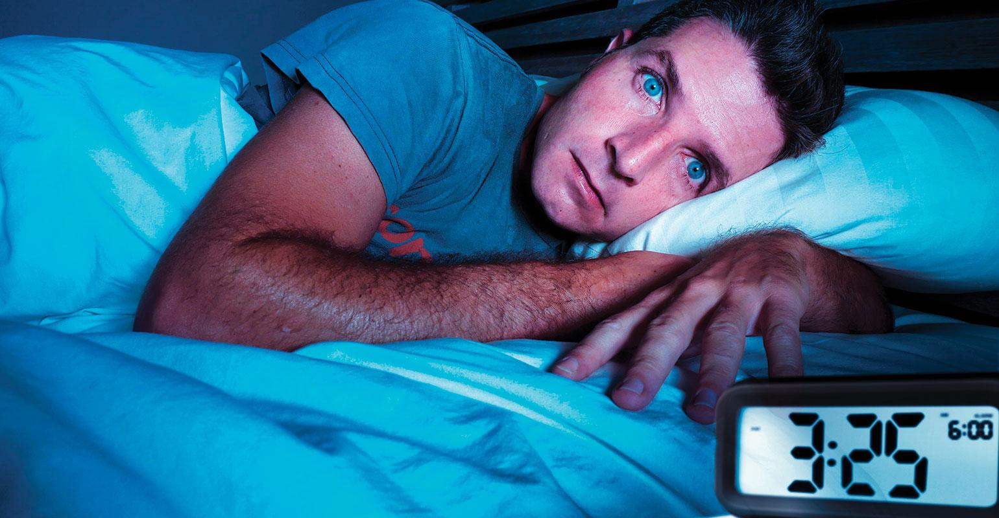
PLAN OF ACTION
Motivation
Block diagram
Pseudo Code
Code Snippet
Analysis
Learning Outcomes
Steps to build a python package

Slide 3
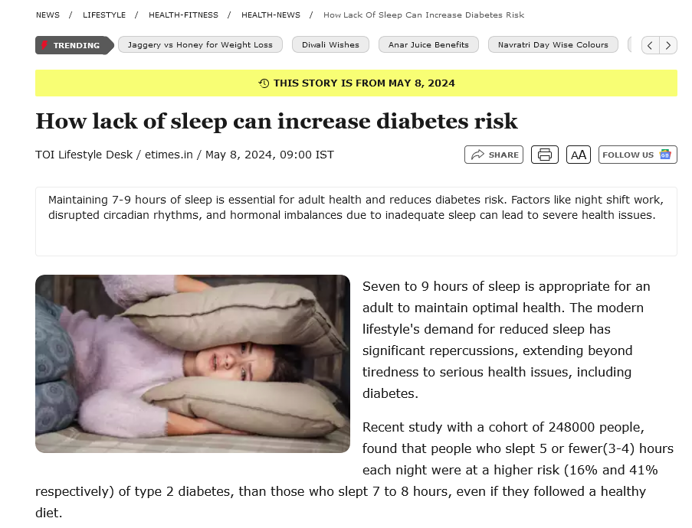
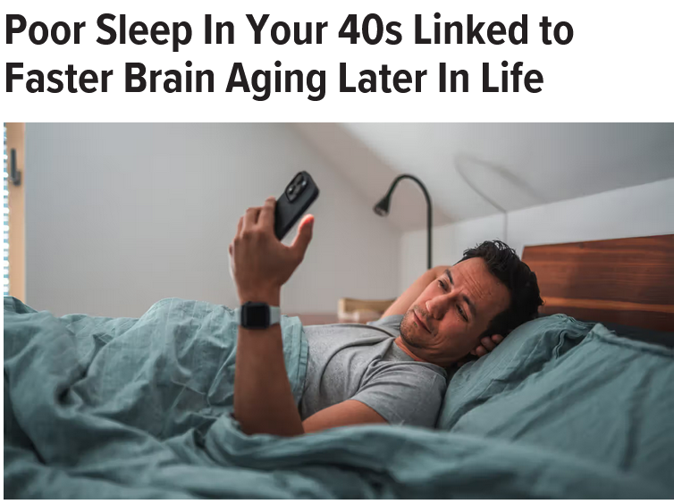
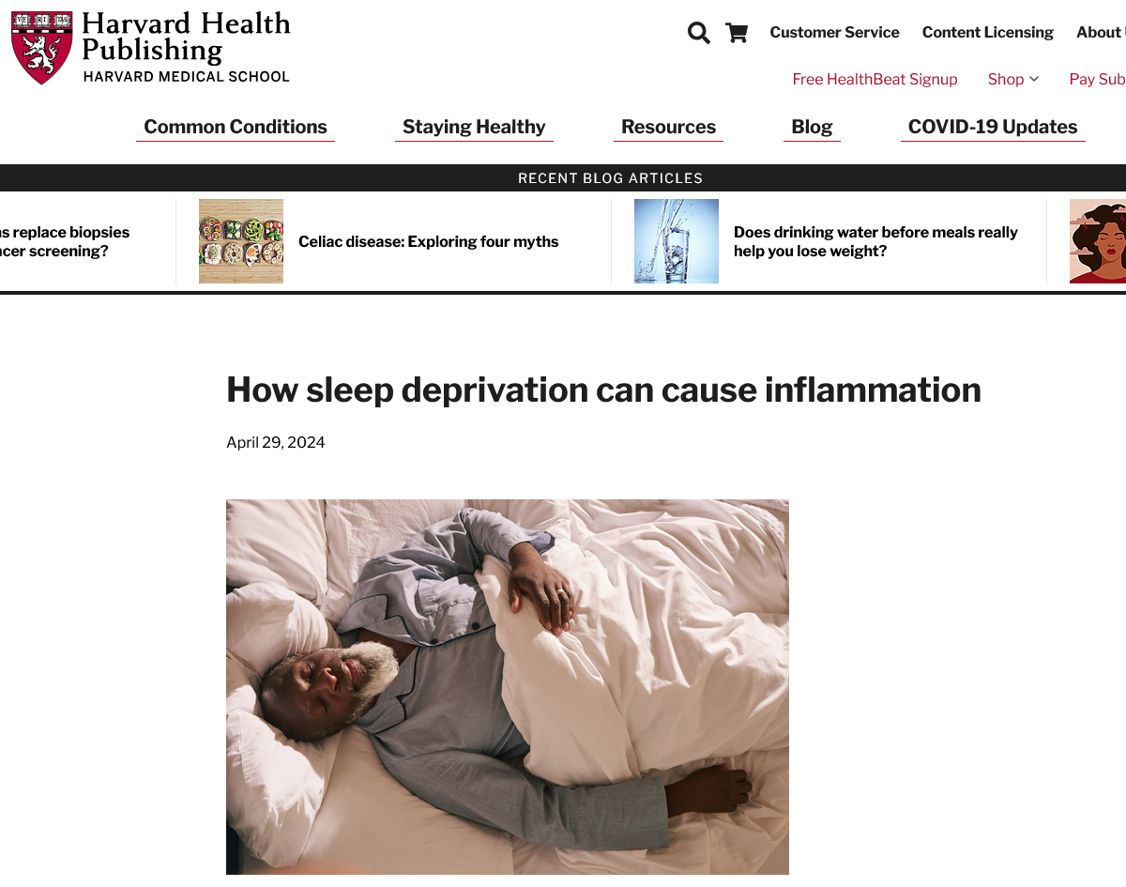
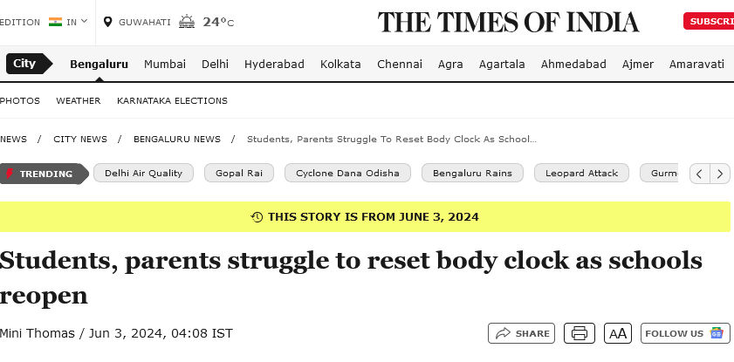
MOTIVATION
Cited from :https://timesofindia.indiatimes.com/life-style/health-fitness/health-news/how-lack-of-sleep-can-increase-diabetes-risk/articleshow/109922360.cms
Cited from: https://www.health.harvard.edu/healthbeat/how-sleep-deprivation-can-cause-inflammation
Cited from: https://www.healthline.com/health-news/poor-sleep-midlife-faster-brain-aging
And the list goes on…..
Cited from
https://timesofindia.indiatimes.com/city/bengaluru/students-parents-struggle-to-reset-body-clock-as-schools-reopen/articleshow/110647156.cms

Slide 4
BLOCK DIAGRAM
Data Collection
Pre- Processing
Break into modules
Get the insights
Visualize the outputs
Perform analysis( Regression, Correlation)

Slide 5
PSEUDO CODE: PROJECT.PY
# 6. Define the analyze_dietary_habits function
Function analyze_dietary_habits(df):
# Perform analysis for Dietary Habits vs Sleep Quality
Create DietaryHabitsAnalysis object with the DataFrame
Call plot_dietary_habits_vs_sleep_quality() to visualize the relationship
# 7. Define the analyze_sleep_disorders function
Function analyze_sleep_disorders(df):
# Perform analysis for Sleep Disorders vs Sleep Quality
Create SleepDisorderAnalysis object with the DataFrame
Call plot_sleep_disorder_vs_sleep_quality() to visualize the relationship
# 8. Define the final_comprehensive_analysis function
Function final_comprehensive_analysis(df):
# Perform the final comprehensive analysis (correlation matrix)
Create FinalAnalysis object with the DataFrame
Call correlation_matrix() to visualize the correlation matrix of all factors
# 9. Define the main function
Function main():
# Load the data
df = Call load_data()
# Perform various analyses
Call analyze_age_vs_sleep_quality() with the loaded data
Call analyze_sleep_duration() with the loaded data
Call analyze_physical_activity() with the loaded data
Call analyze_dietary_habits() with the loaded data
Call analyze_sleep_disorders() with the loaded data
Call final_comprehensive_analysis() with the loaded data
# 10. Execute the main function if the script is run directly
If __name__ == "__main__":
Call main()
# 1. Import required libraries and modules
Import necessary libraries for data analysis and visualization (e.g., Pandas, Seaborn, Matplotlib)
Import custom analysis classes (e.g., DataLoader, DataAnalysis, etc.)
# 2. Define the load_data function
Function load_data():
# Load the dataset
Create DataLoader object to automatically load the built-in CSV file
Display dataset information (e.g., head, shape, data types)
Return the DataFrame for further analysis
# 3. Define the analyze_age_vs_sleep_quality function
Function analyze_age_vs_sleep_quality(df):
# Perform analysis for Age vs Sleep Quality
Create DataAnalysis object with the DataFrame
Call plot_age_vs_sleep_quality() to visualize the relationship
Calculate the correlation coefficient between Age and Sleep Quality
Print the correlation result
# 4. Define the analyze_sleep_duration function
Function analyze_sleep_duration(df):
# Perform analysis for Sleep Duration vs Sleep Quality
Create SleepDurationAnalysis object with the DataFrame
Call process_sleep_times() to process the sleep duration data
Call plot_sleep_time_vs_quality() to visualize the relationship
# 5. Define the analyze_physical_activity function
Function analyze_physical_activity(df):
# Perform analysis for Physical Activity vs Sleep Quality
Create PhysicalActivityAnalysis object with the DataFrame
Call plot_physical_activity_vs_sleep_quality() to visualize the relationship

Slide 6
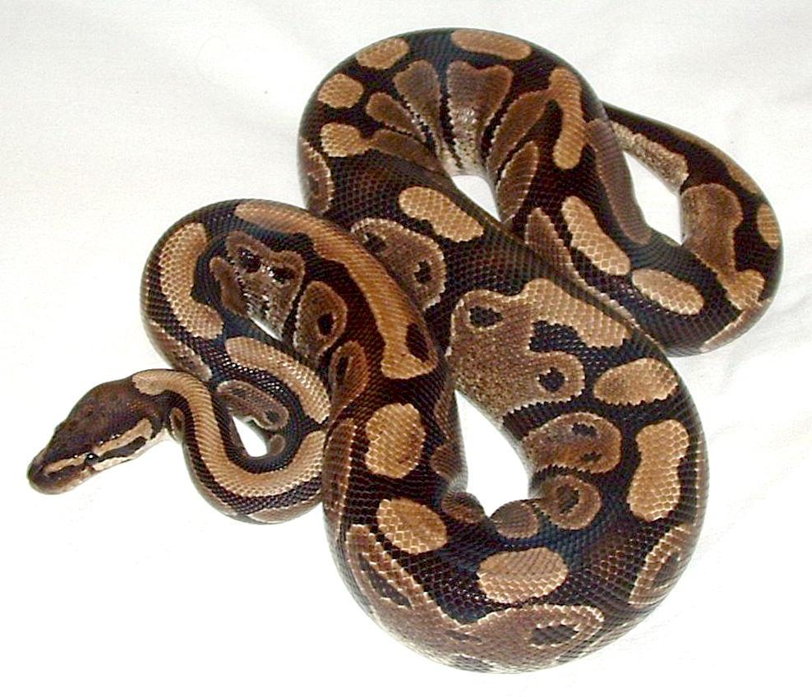
CODE SNIPPET
import pandas as pd # Library for handling data
class DataLoader:
def __init__(self, file_path="Health_Sleep_Statistics.csv"):
self.file_path = file_path # Set the file path
self.df = None # Initialize dataframe
self.load_data() # Load data when the object is created
# Load dataset from CSV file
def load_data(self):
self.df = pd.read_csv(self.file_path)
# Display basic info about the dataset
def display_info(self):
print(self.df.head()) # First few rows of the data
print(self.df.size) # Total number of elements
print(self.df.shape) # Shape of the dataframe
print(self.df.info()) # Info about the dataframe
print(self.df.describe()) # Summary statistics
print(self.df.isna().sum()) # Missing values
print(self.df.duplicated().sum()) # Duplicated rows
print(self.df.columns) # Column names
/sleep_data_anlysis/__init__.py
# Importing DataLoader to handle loading and processing of datasets
from .data_loader import DataLoader
# Importing DataAnalysis class for general analysis and correlation of data
from .data_analysis import DataAnalysis
/project.py
# Import the main classes from the package
from sleep_data_analysis.data_loader import DataLoader
from sleep_data_analysis.data_analysis import DataAnalysis
Pythonic features used:
Classes, method, objects, constructors
Imports
Modular coding
Converting to package and many more…..

Slide 7
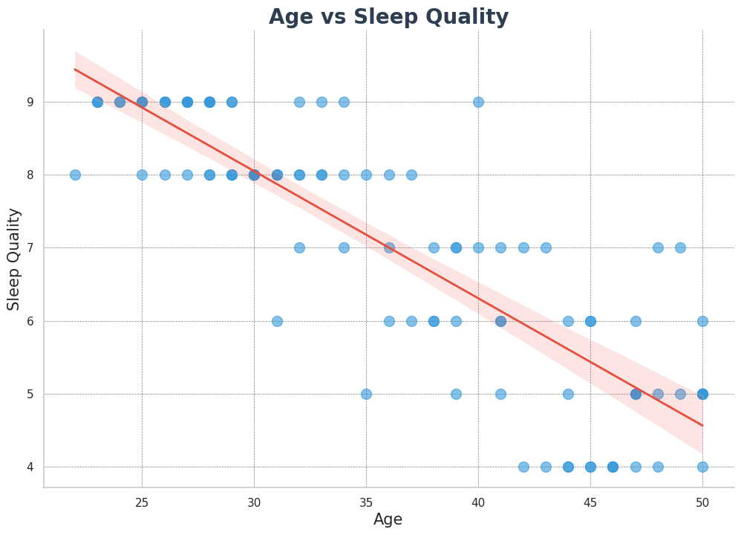
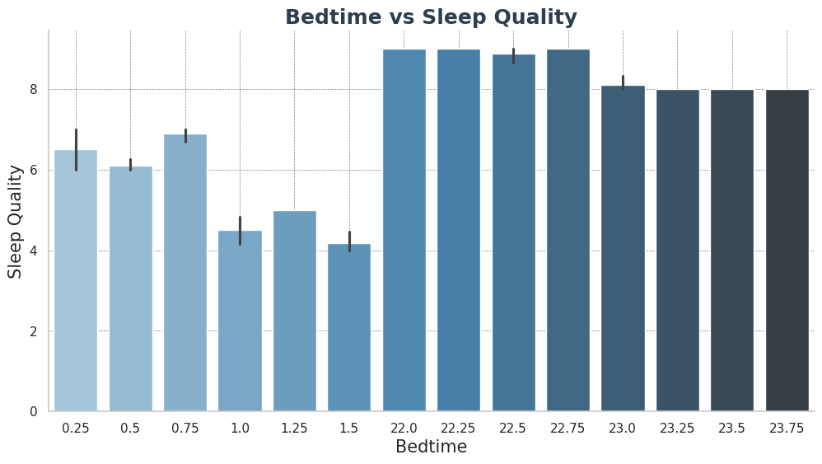
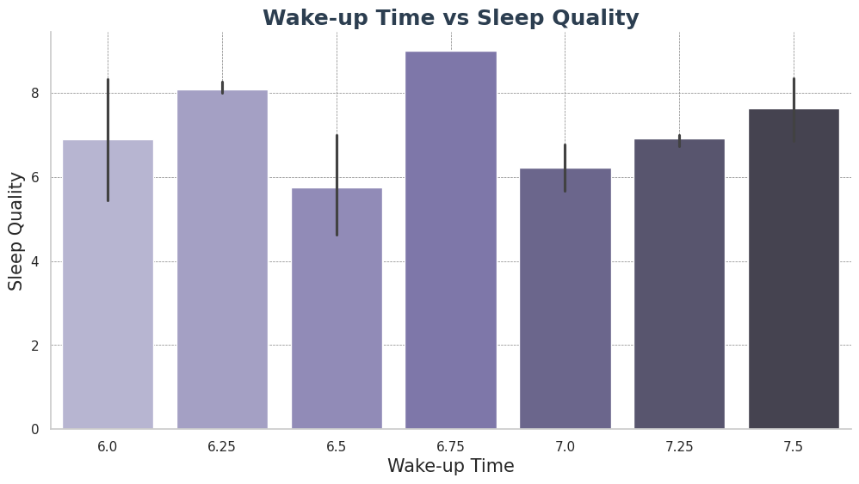
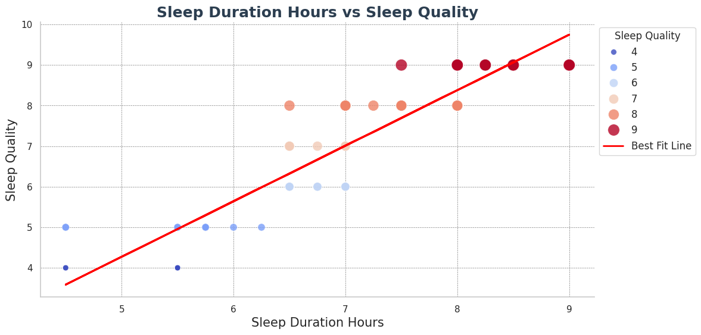
ANALYSIS

Slide 8
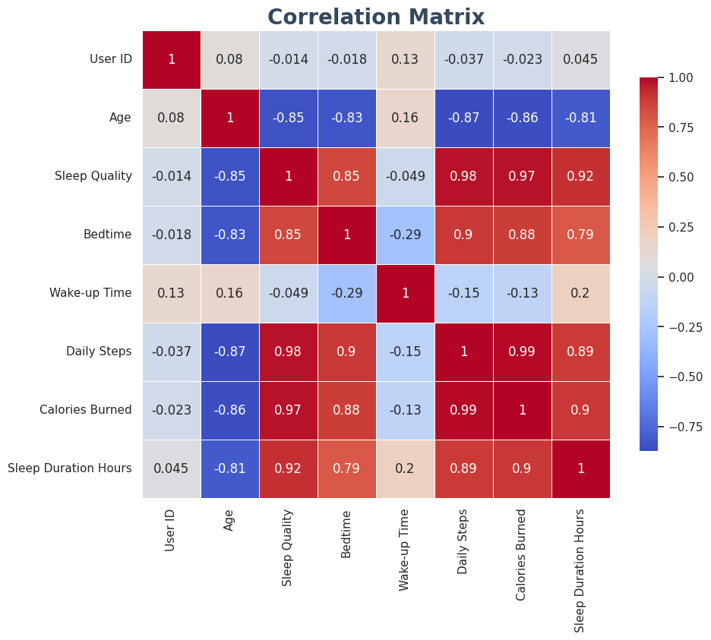
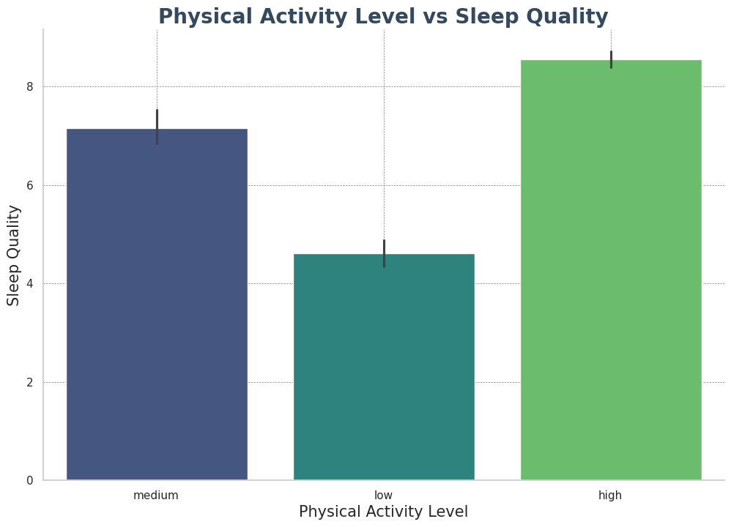
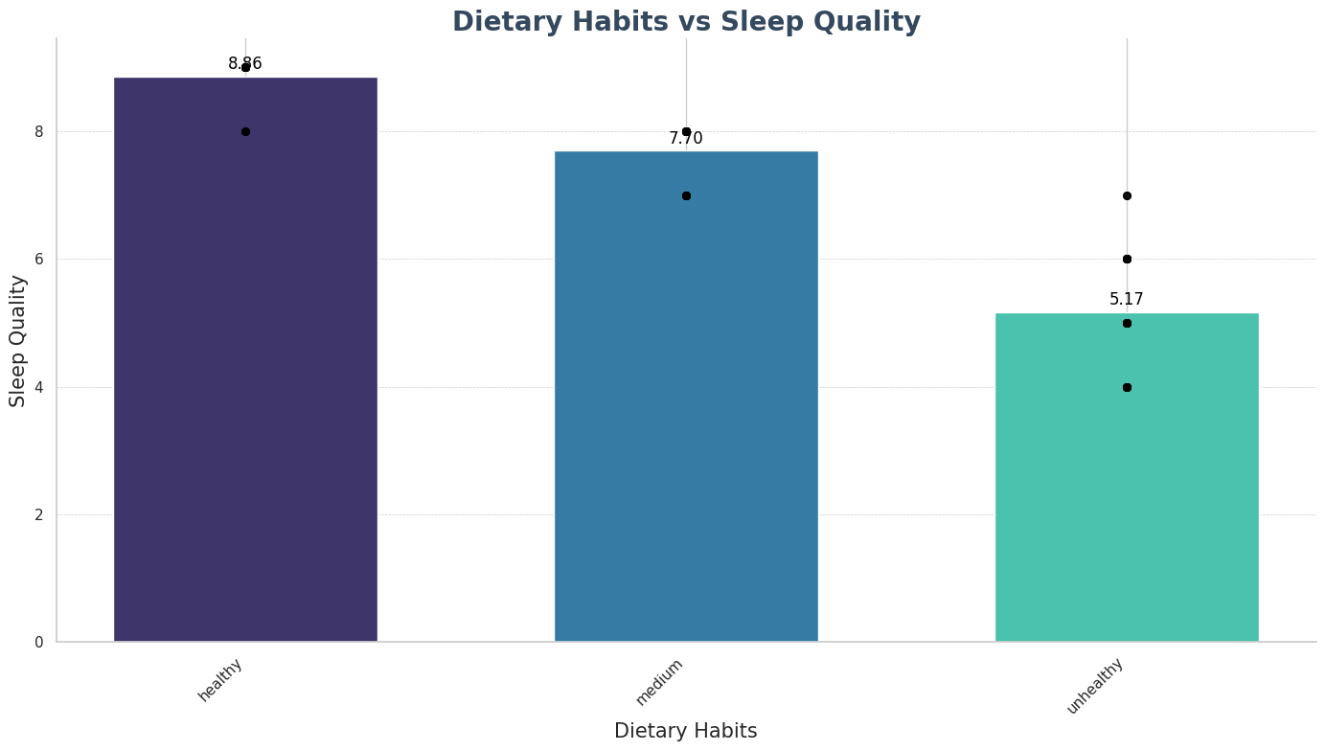
ANALYSIS

Slide 9

LEARNING OUTCOMES
Data analysis tools
Data Cleaning and Preprocessing
Exploratory Data Analysis (EDA)
Regression and Correlation Analysis
Visualization and Reporting
Error Handling and Debugging
Understanding the Impact of Sleep Data
Modular coding
Building a Python Package
Last but not the least, lets learn to create your own python package within minutes

Slide 10
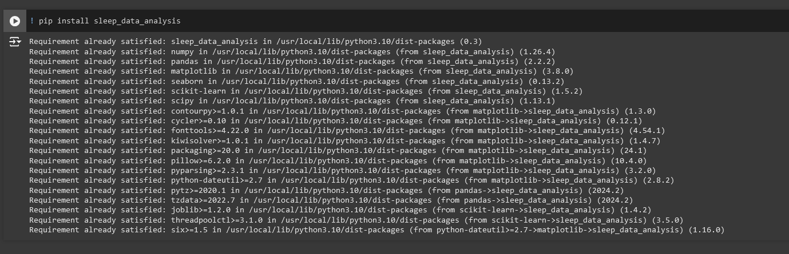
STEPS TO BUILD A PYTHON PACKAGE
sleep_data_analysis/
│
├── sleep_data_analysis/ # Main package directory
│ ├── __init__.py # Marks this directory as a package
│ ├── data_loader.py # Your module file
│ ├── data_analysis.py # Your module file
│ ├── sleep_duration_analysis.py # Your module file
│ ├── physical_activity_analysis.py # Your module file
│ ├── dietary_habits_analysis.py # Your module file
│ ├── sleep_disorder_analysis.py # Your module file
│ ├── final_analysis.py # Your module file
│
├── setup.py # Setup script for installation
├── README.md # Description of your package
├── requirements.txt # External dependencies
├── MANIFEST.in # File to include non-Python files
├── LICENSE # License file
1. Organize Your Project Structure
2. Create the setup.py File
3. Create a requirements.txt File
4. Create a MANIFEST.in File:
5. Create __init__.py File:
6. Build the Package:
python setup.py sdist bdist_wheel
7. Create account in Pypi
8.Upload the Package to PyPI
pip install twine
Twine upload dist/*
9.Install Your Package and use
pip install sleep_data_analysis

Slide 11


